Slide 1
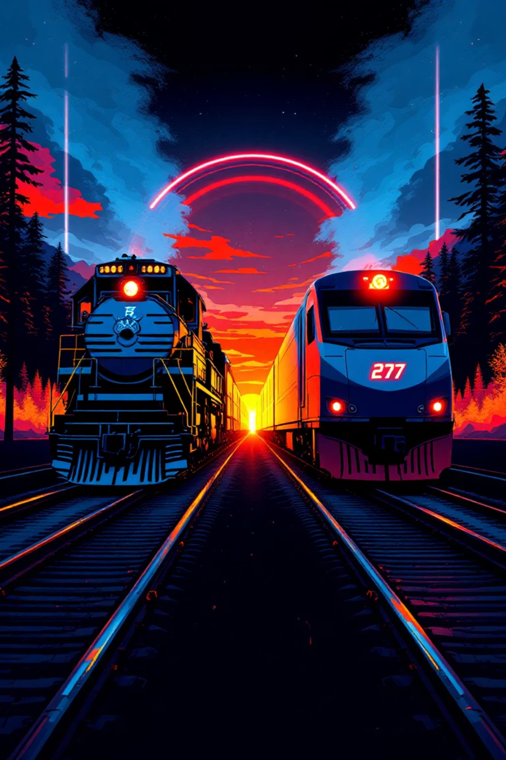
The Unwavering Steel: Org's AI-Powered Future
A legacy spanning 140+ years. A titan that has moved history itself. But today, the disruptive force reshaping our industry isn't made of water—it's made of data, intelligence, and lightning-fast innovation.

Slide 2

Our Proud Legacy: Not a Guarantee
Since 1881, Org has stood as the backbone of North American commerce. Through world wars, economic depressions, and countless technological shifts, our resilience has been our hallmark.
But even the mightiest mountain can be reshaped by the slow, inexorable force of a river. Today's river is made of data and AI-driven innovation.
Our competitors aren't just other rail companies—they're disruptors, data-driven logistics firms, and technology giants redefining how goods move across continents.

Slide 3




The Ikigai of Org: Finding Our Center
The Japanese concept of Ikigai represents our "reason for being"—the intersection of four essential elements:
What we love
What we're good at
The legacy of moving a nation, the pride of overcoming monumental challenges
1
2
Engineering excellence, safety protocols, and a vast physical network
What we can be paid for
What the world needs
A profitable enterprise that serves customers and creates shareholder value
4
3
Efficient, sustainable, and reliable transportation of goods
Our core Ikigai is sound—but the intersection is being challenged by competitors who match our strengths with greater speed and precision.

Slide 4
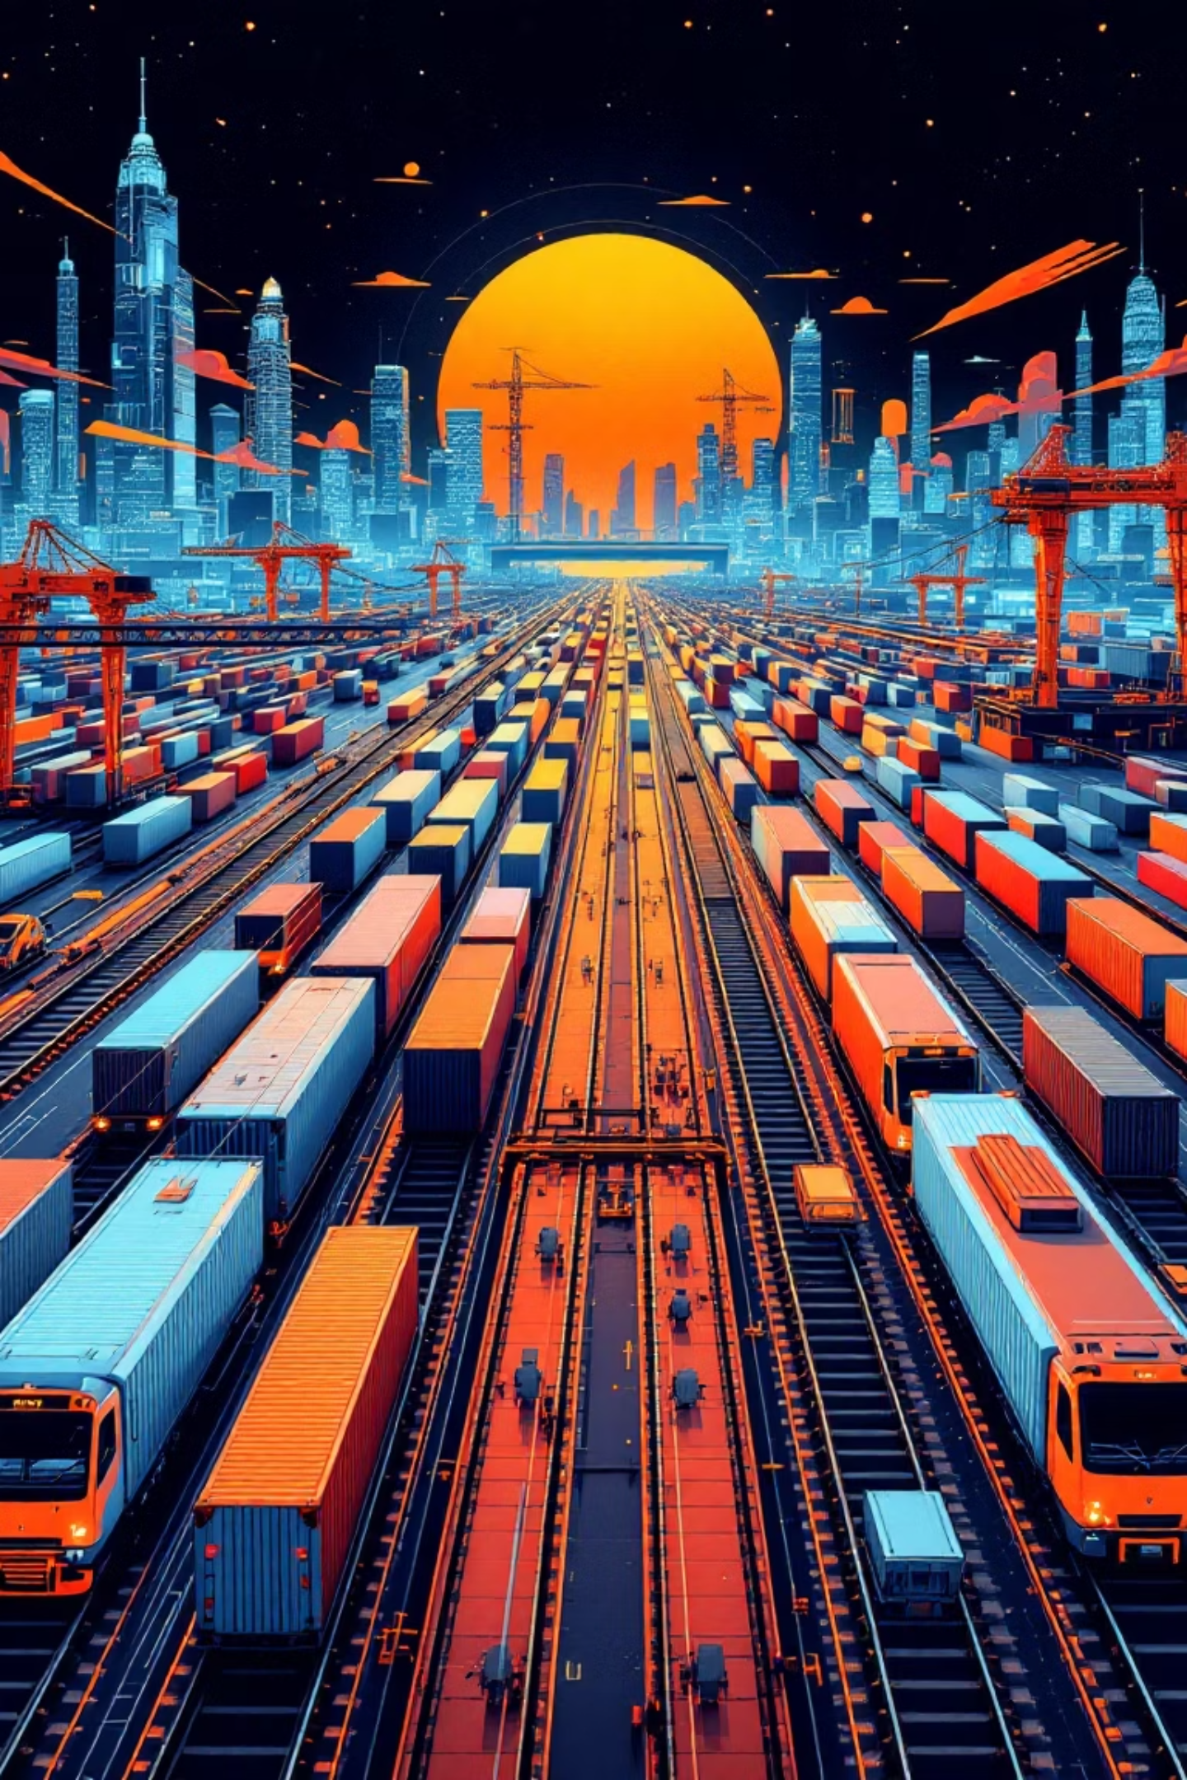
SWOT: Our Bedrock Strengths
Unparalleled Legacy
A trusted name across North America for over 140 years, with deep customer relationships and institutional knowledge
Vast Infrastructure
An extensive rail network spanning the continent, representing physical assets that can't be easily replicated
Operational Expertise
Decades of experience in complex logistics operations across diverse environments and conditions
Merger Synergies
The combined strength of CP and KCS offers new routes and unprecedented market access

Slide 5
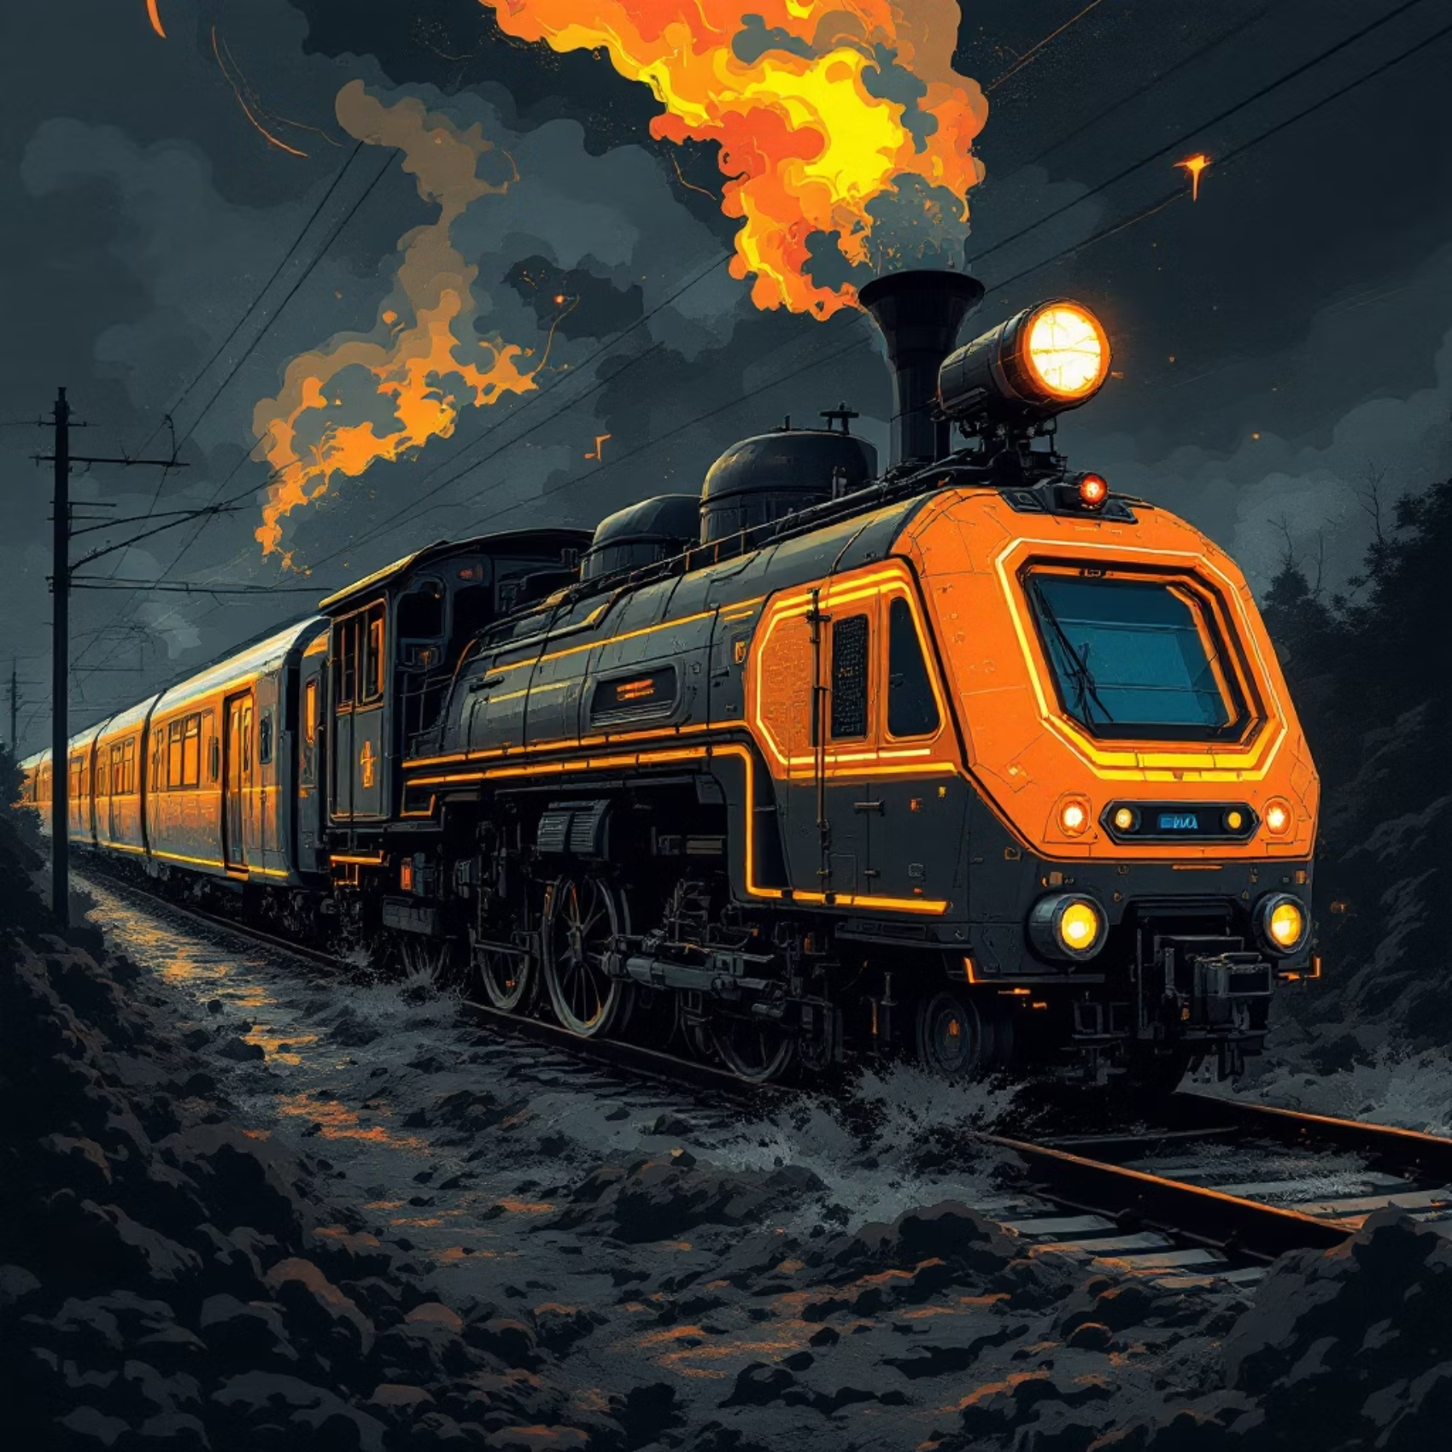
SWOT: The Chinks in Our Armor
Legacy Mindset
The perception of being "too big to fail" has created resistance to change and complacency
Slow Technology Adoption
Traditional processes are less agile than competitors', limiting our ability to innovate quickly
Risk of Disruption
Vulnerable to competitors offering more personalized, data-driven logistics solutions
Operational Inefficiencies
Without AI and automation, hidden inefficiencies persist in routing, maintenance, and resource allocation

Slide 6

The question isn't whether our competitors will catch up—
It's whether they will surpass us.

Slide 7
Competition: Not Standing Still
While we focus on our past achievements, Competition is building the railway of the future:
1%
65%
Actively exploring AI implementation for years
Derailment Reduction
Faster Resolution
Using data to optimize routes and predict maintenance needs
Even this small improvement through AI creates enormous safety and cost benefits
AI-powered customer support resolves issues in minutes vs. hours
Improving customer service through digital transformation
Reducing major derailments through predictive analytics
This is not a hypothetical threat—it's happening right now.

Slide 8
The Smart Rail Initiative: Our Path Forward
This isn't about replacing our people or legacy—it's about empowering them through strategic, phased adoption of Generative AI:
Phase 1: Foundation
1
6-12 months
Implement foundational AI tools for back-office functions, automating administrative tasks and analyzing supply chain data
2
Phase 2: Predictive Power
12-24 months
Launch pilot program for predictive maintenance using AI. Deploy sensors on locomotives to predict component failures before they happen
Phase 3: Customer-First
3
24-36 months
Introduce AI-powered customer portal with instant, accurate information on shipment status and personalized solutions
4
Phase 4: The Intelligent Network
36+ months
Integrate AI across the entire network, creating a truly "intelligent network" that dynamically reroutes trains and responds to disruptions

Slide 9
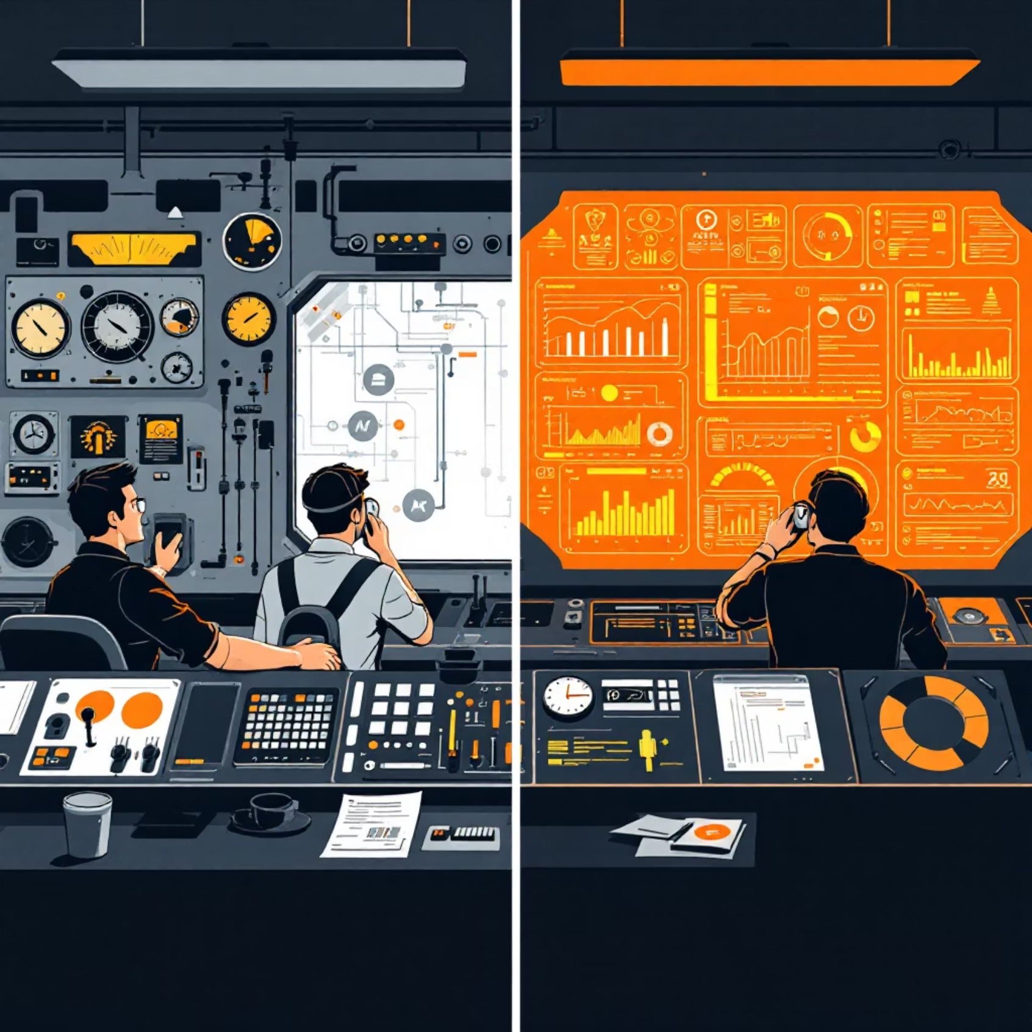
Transformational Benefits
Operational Excellence
30-40% reduction in unscheduled downtime through predictive maintenance
Customer Loyalty
Real-time visibility and proactive issue resolution creating unmatched experience
Employee Empowerment
AI handling routine tasks, freeing skilled workers for high-value decisions
Competitive Advantage
Establishing Org as the innovation leader in North American rail

Slide 10
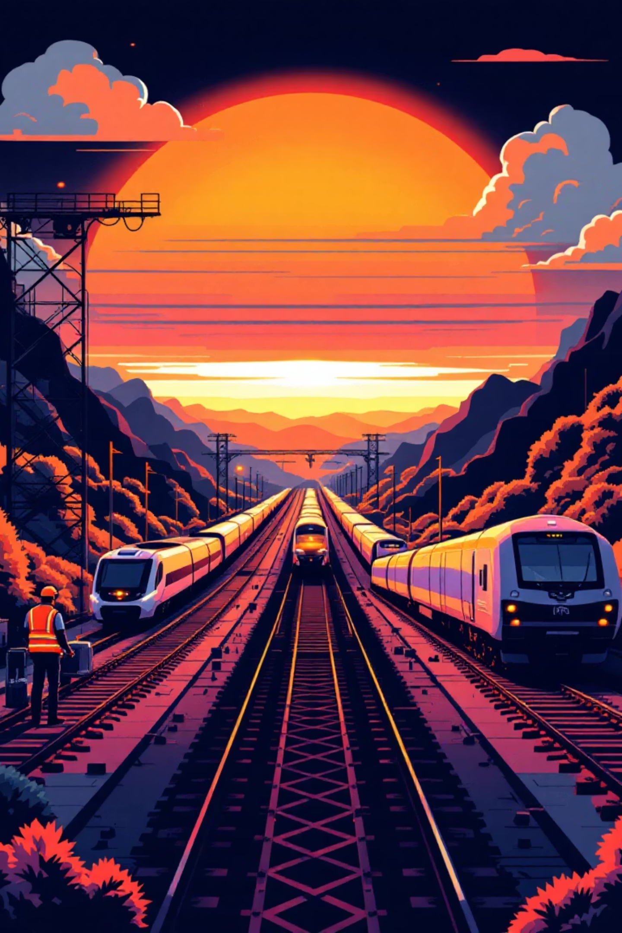
The Legacy of Innovation
Org's legacy isn't just about what we've done; it's about our capacity to adapt and overcome. Our past triumphs were built on innovation—the steam engine, the transcontinental railway.
Today, our engine is data, and our railway is the digital network. To continue as the backbone of North America, we must embrace the intelligence that will make us stronger, safer, and more indispensable than ever before.
This is not a threat—it's our next great chapter.

